Slide 1
How asymmetries in the feedforward signals are exploited by target neurons to elaborate feature selectivity
Yamni Mohan
Supervisors: Prof. TR Vidyasagar; Dr. Ekaterina Levichkina
(also- Dr. Sivaram Viswanathan and Dr. Jaikishan Jayakumar)

Slide 2
Introduction

Slide 3
Part 1: Sub-cortical Orientation Biases
Two parts
Orientation Tuning in the Superior Colliculus
Orientation Biases in the inputs to the cortex

Slide 4
Orientation Tuning of the Superior Colliculus neurons
Introduction

Slide 5
Orientation Tuning of the Superior Colliculus neurons
Methods

Slide 6
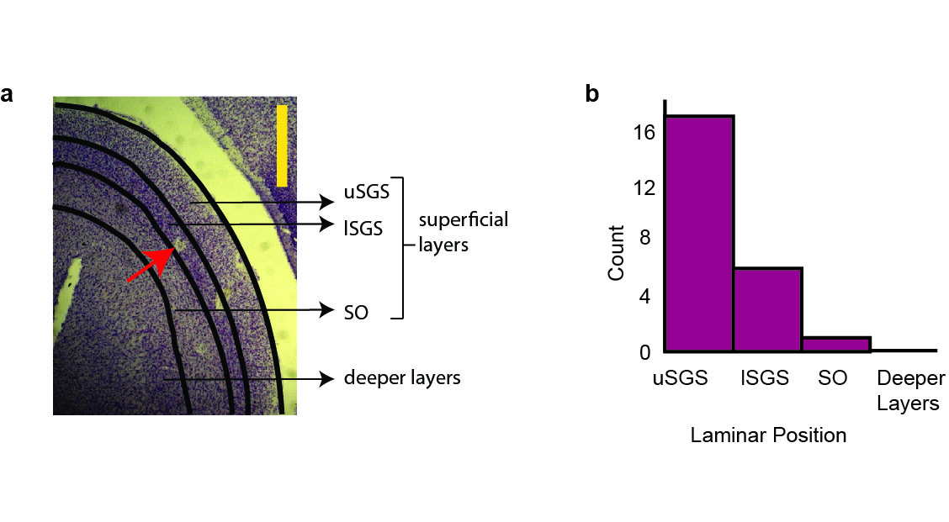
Most neurons were from the superficial (visual) layers

Slide 7
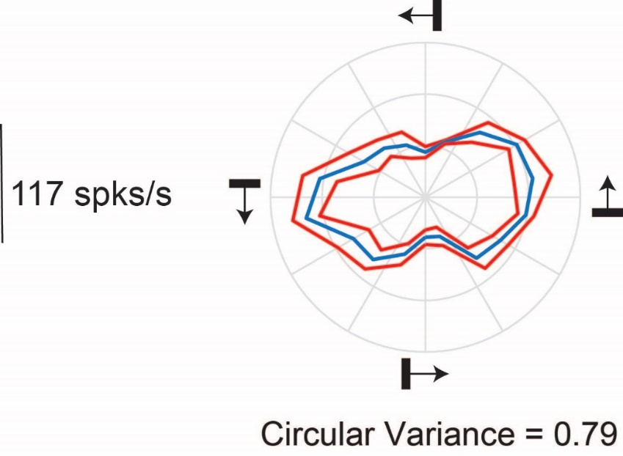
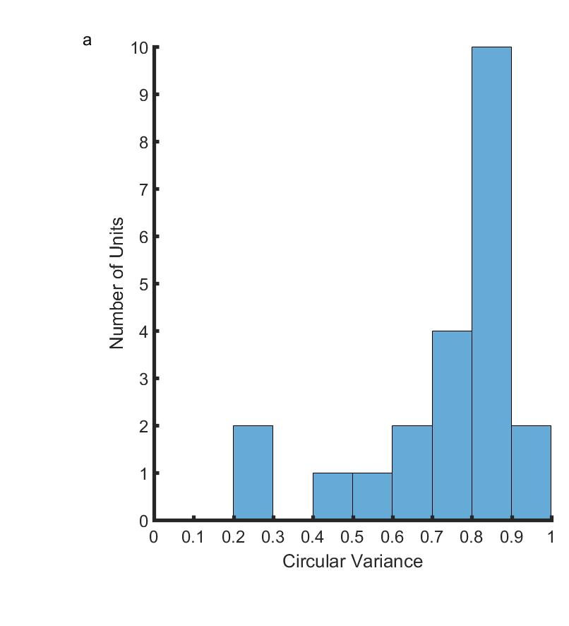
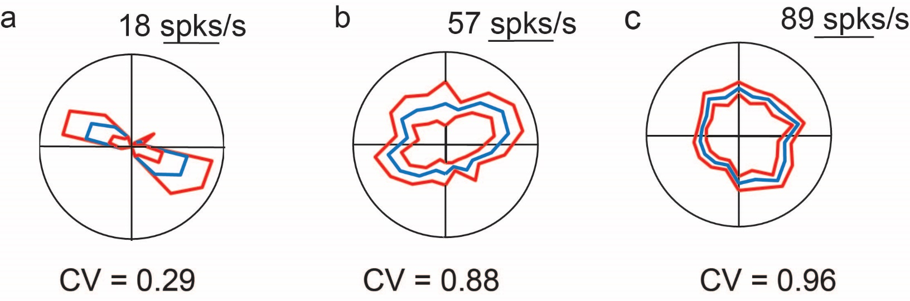
These neurons were orientation tuned in response to bars

Slide 8
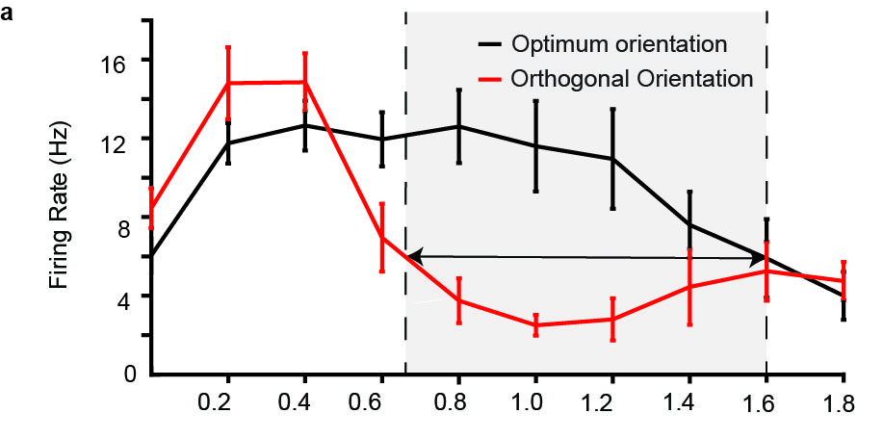
This orientation tuning was related to the spatial frequency of the stimulus

Slide 9
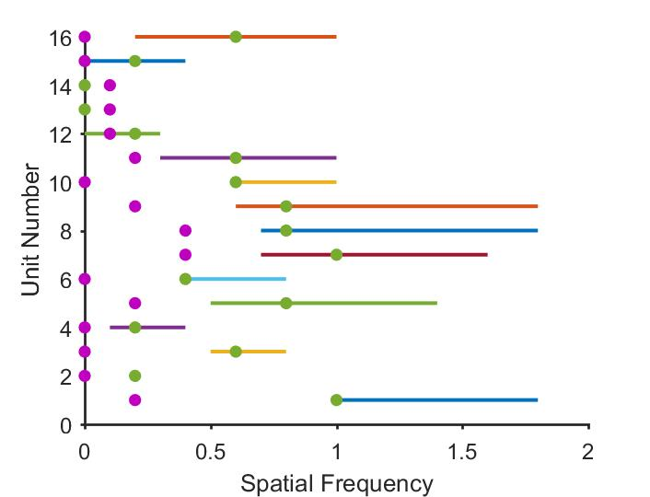
Orientation Selectivity is more prominent at higher spatial frequencies where the cortical neurons typically respond.

Slide 10
Discussion

Slide 11
Summary
Neurons in the SC are similar to the neurons in the retina and the LGN in CATS---
What does that really mean?

Slide 12
Orientation biases in the inputs to the cortex
Looked at the orientation tuning in the V1 of the primary visual cortex.
Inputs?
Used optical imaging of intrinsic signals

Slide 13
Inputs?
Rationale for the unfiltered signal compared to the filtered signal.

Slide 14
Method
OI- What do we do?

Slide 15
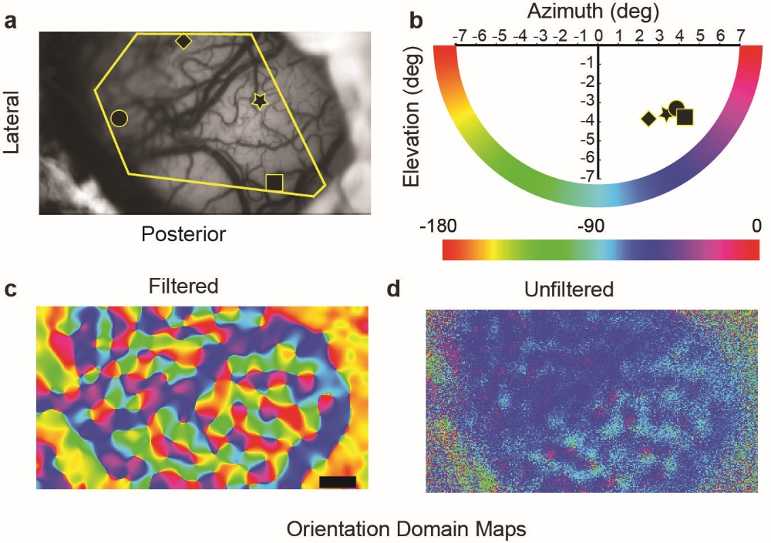
Unfiltered signal is mostly tuned to the radial orientation.

Slide 16
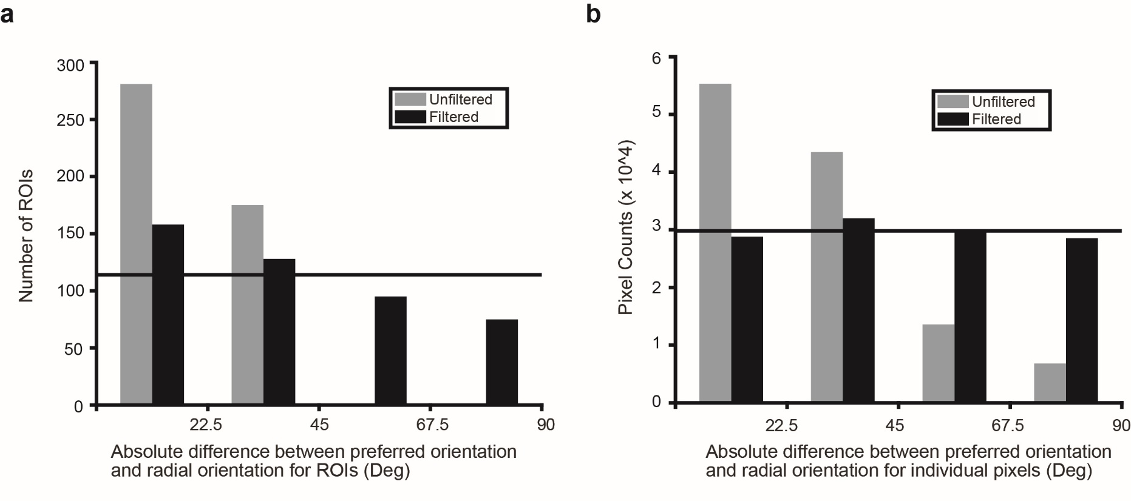
This tuning is on a fairly fine spatial scale

Slide 17
Also present on a single pixel level
ROI
Single Pixel

Slide 18
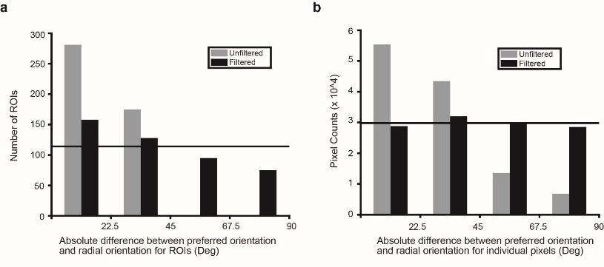
We also looked at array data
LFP data ~ Unfiltered
MUA data ~ Filtered

Slide 19
Discussion

Slide 20
Conclusion
Inputs are tuned to radial orientation- So what?

Slide 21
Part Two: Tree Shrew Primary Visual Cortex
Why study it?
What has been done so far?

Slide 22
Orientation Tuning
Organisation
Mechanism

Slide 23
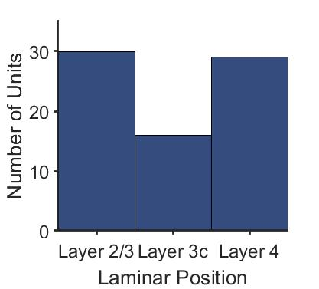
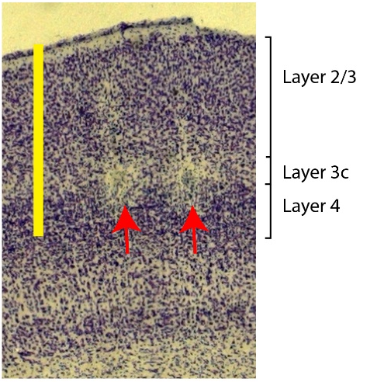
The cortical layers

Slide 24
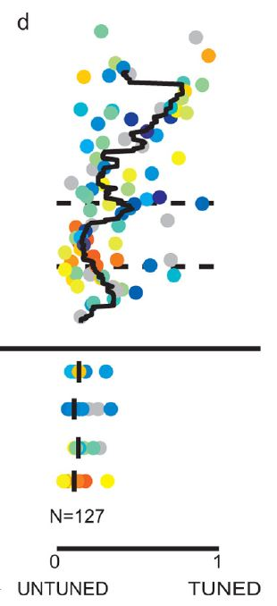
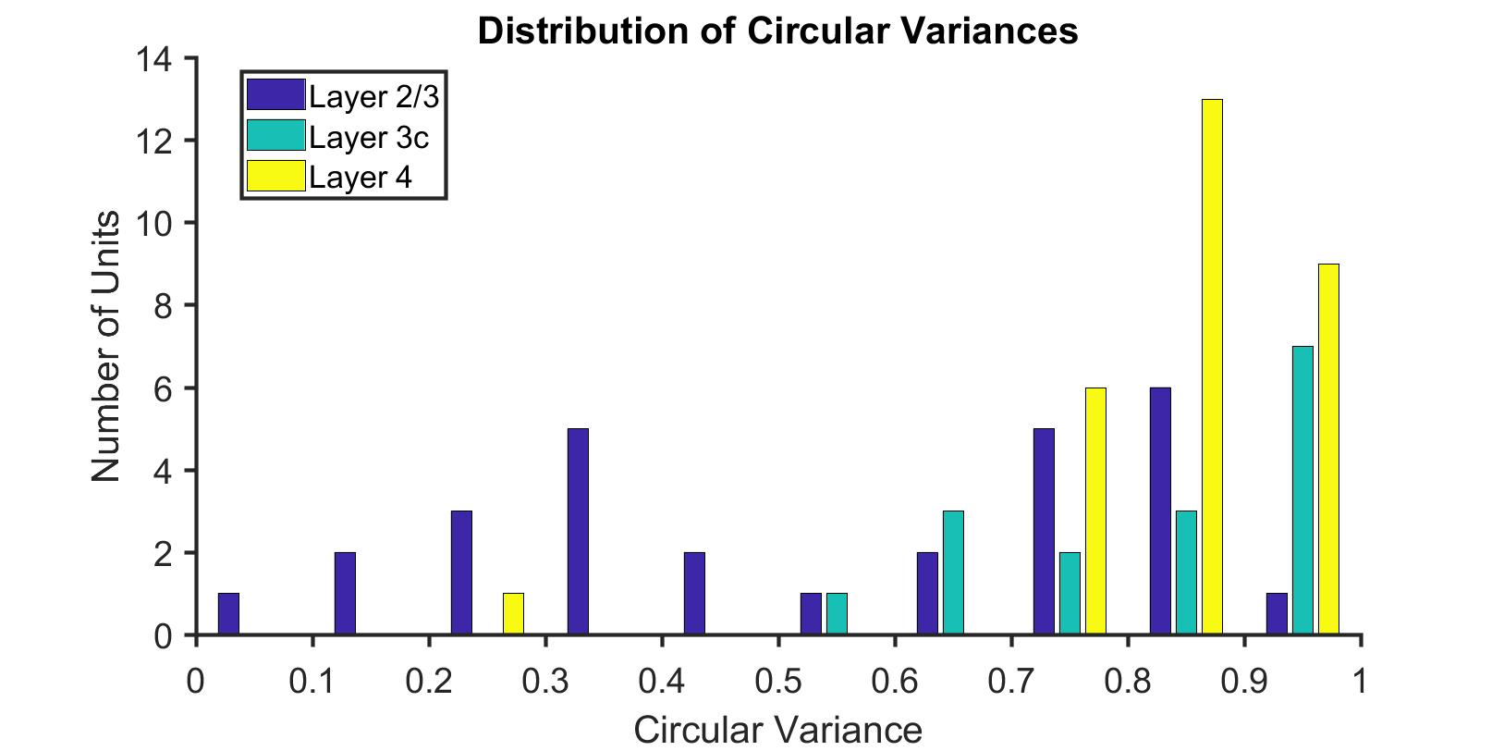
Distribution of Orientation Tuning in V1

Slide 25
Track Orientation
So far… layer 4 was thought to be unoriented.
Does the orientation remain same down the layers?

Slide 26
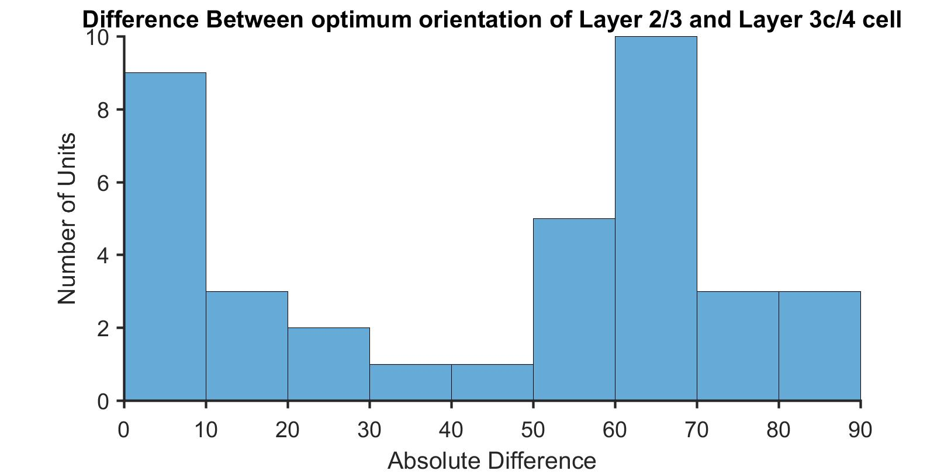
Orientation selectivity within a column
Difference in orientation selectivity between layer 2/3 cell and the layer 3c/4 cell within a track
N=37 pairs

Slide 27
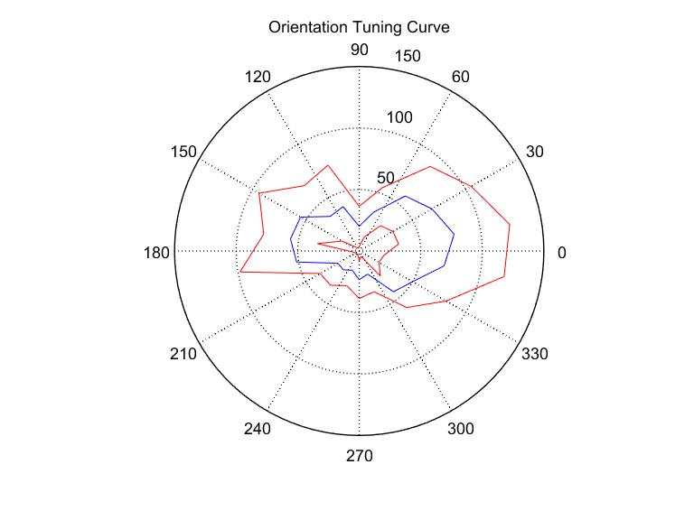
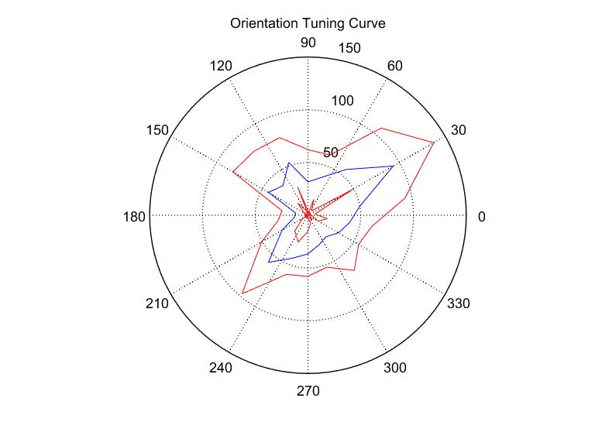
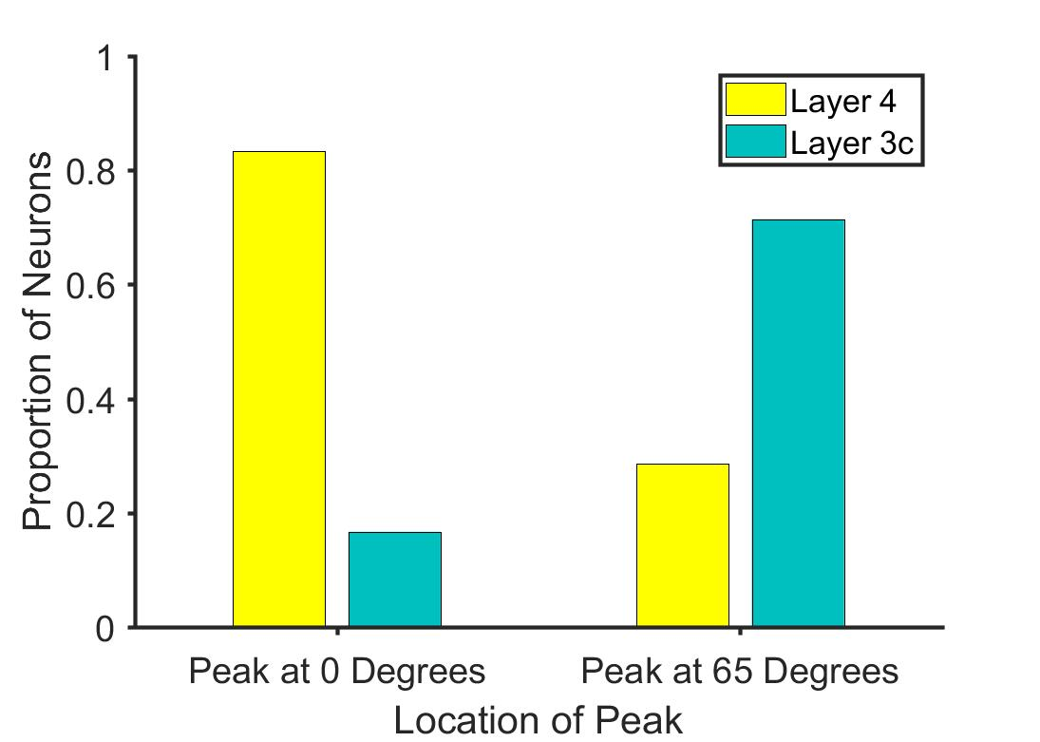
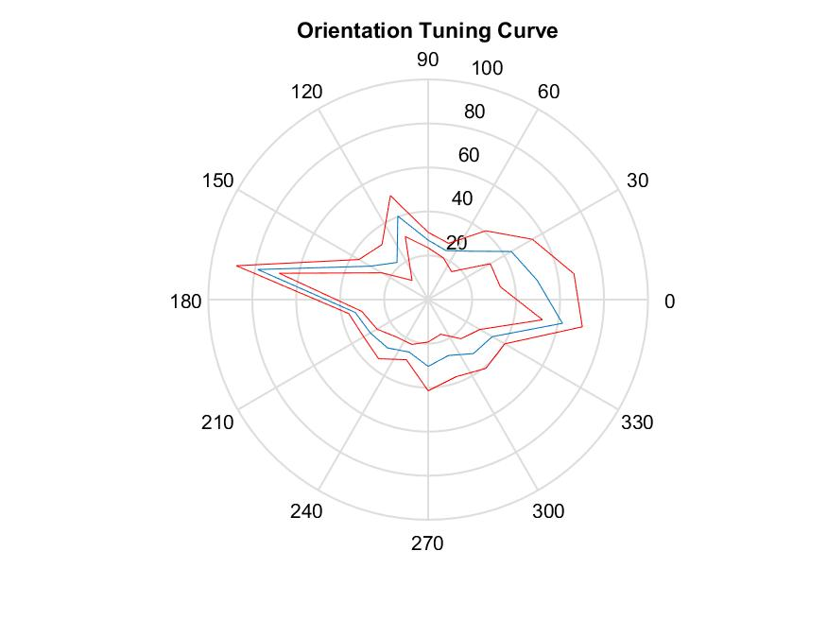
Layer 2/3
Cm= -5.7º
Layer 3c
Cm= 60.36º
Layer 4
Cm= 174.75º
P=0.016, Binomial Distribution
N=12
P=0.026, Binomial Distribution
N=21

Slide 28
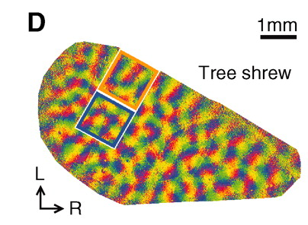
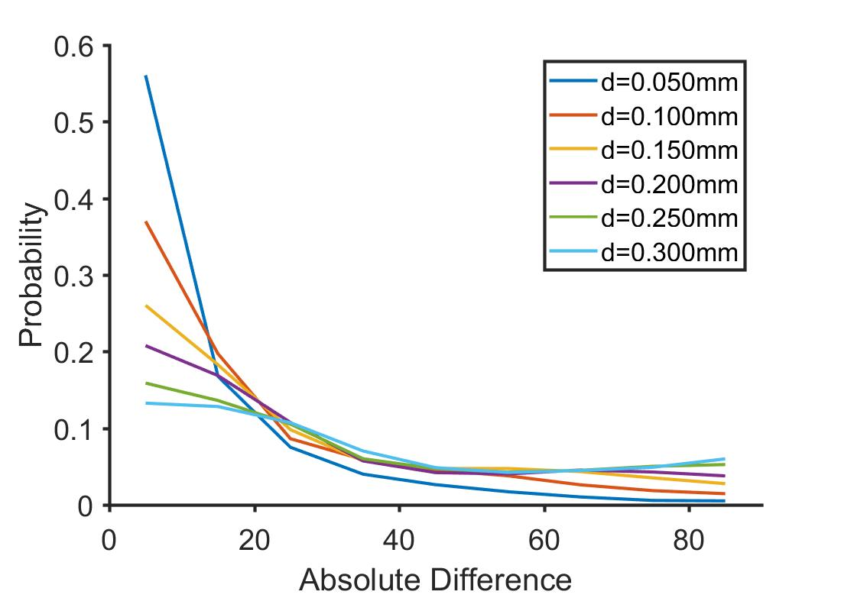
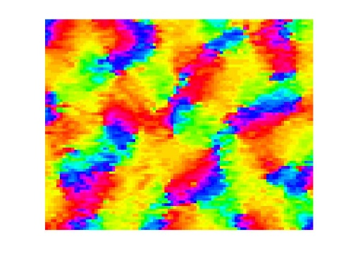
Orientation selectivity within a column- Is it chance?
Probability of getting a peak at 65º
Highest at d=0.25; p=0.045
Lowest at d=0.05; p=0.01

Slide 29
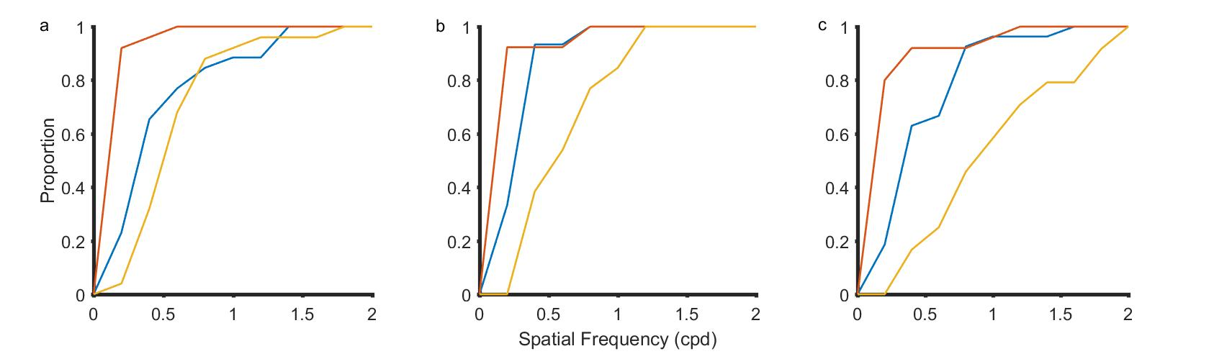
Spatial Frequency Tuning
Organisation
It’s role in orientation tuning
Layer 4
Layer 3c
Layer 2/3

Slide 30
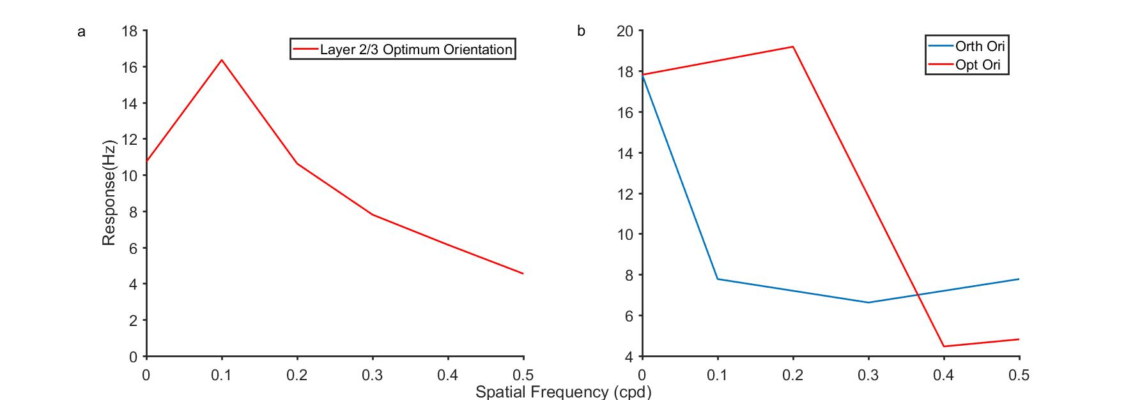
Spatial Frequency Tuning and orientation tuning (Layer 2/3 and input layer cells)

Slide 31
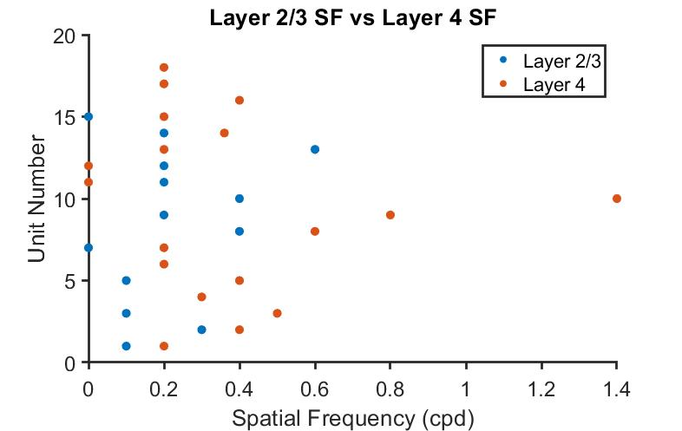
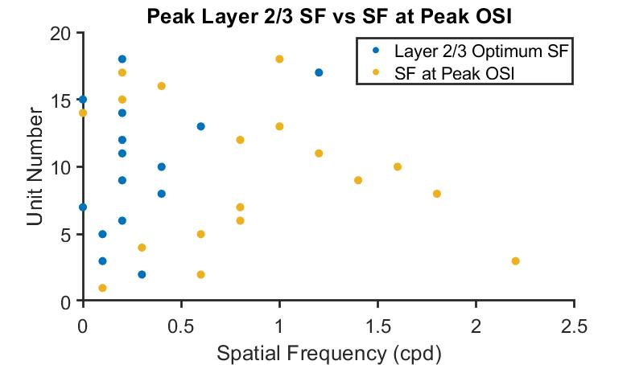
Doesn’t have the same effect as in cats and macaques

Slide 32
Linearity of receptive field responses
Simple vs Complex cells.
Simple vs Complex cells???
RF organisation
Are the shrew neurons actually

